Slide 1
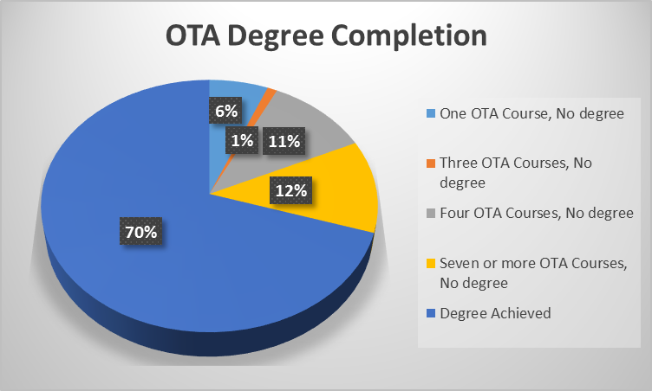
Data requested by BA committee
Occupational Therapy Assistant AS degree
Degree completion rates for students who complete at least one OTA course:
Cohort first attending SAC spring 2010 through fall 2011
Prepared: 4/27/17

